Slide 1

Risk Analysis of Indian Markets
By :
Kratika Aggarwal
Pranay Manikanta Narava

Slide 2
Table of Contents
Introduction
Data
CAPM
FAMA French 3 Factor Model(FF3F)
Comparison of Expected Returns of CAPM vs FF3F
Limitations of CAPM
Conclusion

Slide 3

Introduction
A prevalent question in today's world is "How an investor should value risky securities". The general overview is that an investor demands higher expected rate of return for investment in riskier projects or securities. Estimation of expected return and risk associated with investment in risky securities is in dispensable to many financial decisions such as those relating to portfolio management, capital budgeting, and performance evaluation.
Prevailing modern investment theories are embedded largely on two initial concepts. The first, due to the work of Harry Markowitz, is that in an efficient financial market, higher risk exposure leads to higher return expectations. The second concept established by William F. Sharpe, is that since the risks(unsystematic risk) associated with individual securities tend to offset each other in diversified portfolios, the relevant factor is systematic risk. Hence investor is a paid off for exposure to greater "systematic" risk(risk that cannot be diversified away). This concept is known as the Capital Asset Pricing Model (CAPM) presented by William F. Sharpe. In recognition of their formative work both economists, Harry Markowitz and William F. Sharpe, received Nobel Prizes.

Slide 4
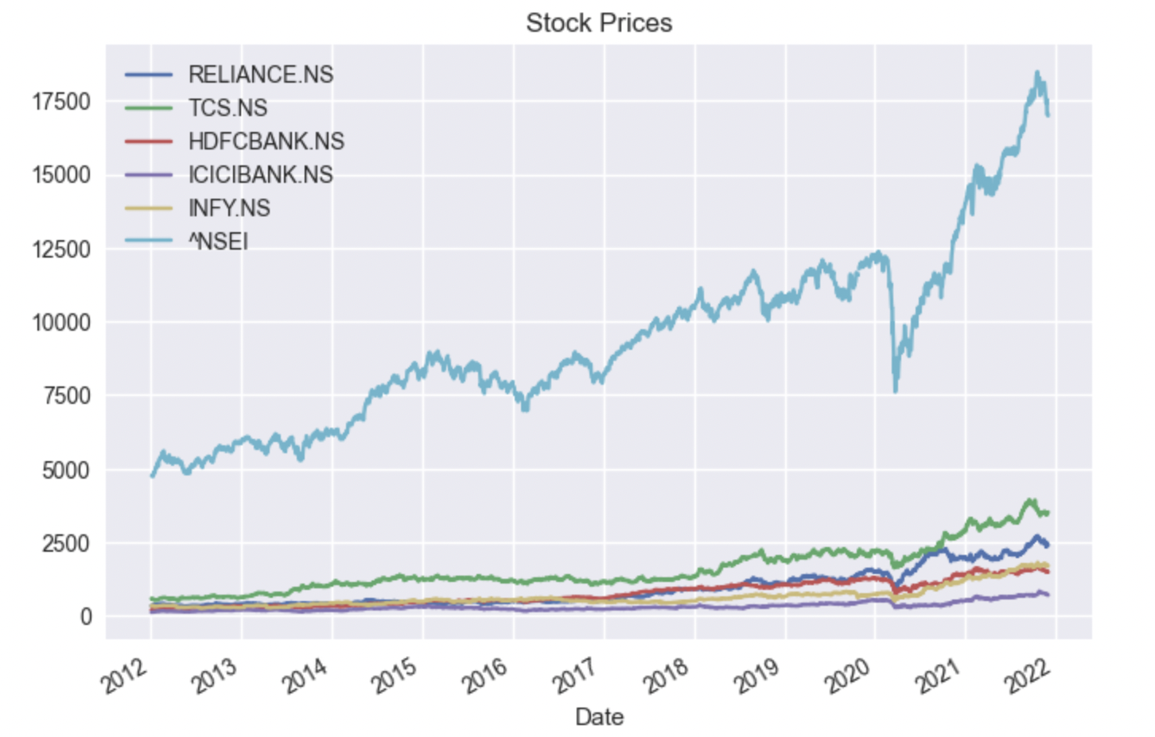
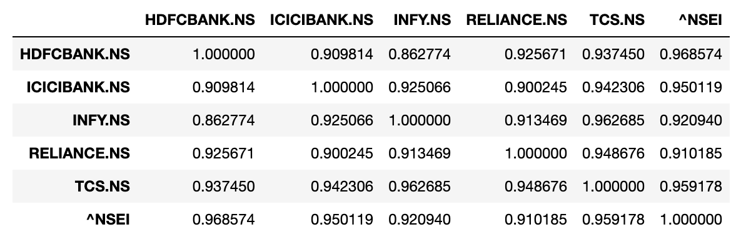
DATA
The stock market prices have been sourced from Yahoo Finance from 2012 to 2021 on a daily-basis.
Market Index – NIFTY50
Fig : Correlation Plot

Slide 5
Capital Asset Pricing Model
It examines the systematic risk (β) and expected return in a competitive market.
It is a parametric and univariate approach.
The aim of this method is to price an individual security or a portfolio.
ER_{i} =R_{f} +β_{i} (ER_{m} −R_{f} )
ER_{i} = Expected return of investment
R_{f} = Risk-free rate
β_{i} = Beta of the investment
(ER_{m} −R_{f} ) = Market Risk Premium

Slide 6
Capital Asset Pricing Model
 |  | Beta
Stock | R2 | P>|t| | Coefficient
RELIANCE.NS | 0.71 | 0 | 1.0329
TCS.NS | 0.602 | 0 | 0.8834
HDFCBANK.NS | 0.817 | 0 | 1.0055
ICICIBANK.NS | 0.706 | 0 | 1.1345
INFY.NS | 0.581 | 0 | 0.9254

Slide 7
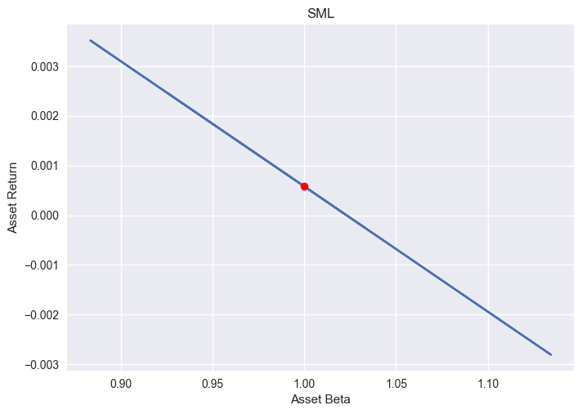
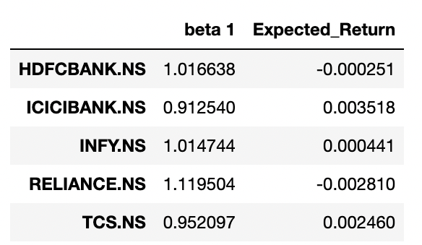
Capital Asset Pricing Model
Interpretation:
1. HDFCBANK, INFY, RELIANCE - Riskier than the benchmark market
2. ICICIBANK, TCS - less risky than the benchmark market

Slide 8
Fama French 3 Factor Model
The Fama-French model is an extension to the one-factor Capital Asset Pricing Model (CAPM). A new model was created because CAPM isn’t flexible and doesn’t take into consideration overperformance.
Rit −Rf_{t} =α_{it} +β₁ (R_{Mt} −R_{ft} )+β₂ SMB_{t} +β₃ HML_{t}
R_{it} =total return of a stock or portfolio i at time t
R_{ft} =risk free rate of return at time t
R_{Mt} =total market portfolio return at time t
R_{it} −R_{ft} =expected excess return
R_{Mt} −R_{ft} =excess return on the market portfolio (index)
SMB_{t} =size premium (small minus big)
HML_{t} =value premium (high minus low)
β_{1,2,3} =factor coefficients

Slide 9
Fama French 3 Factor Model
SMB
HML
SMB(Small Minus Big) = Historic excess returns of small-cap companies over large-cap companies.
SMB = 1/3 (small value returns +
small neutral returns +
Small growth returns) -
1/3 ( big value returns +
big neutral returns +
big growth returns)
HML(High Minus Low) = Historic excess returns of value stocks over growth stocks
HML = ½( small value returns +
Big value returns) -
½ (small growth returns +
big growth returns)

Slide 10
Fama French 3 Factor Model
 |  | Beta1 |  | BETA 2(SMB) |  | BETA 3 (HML)
Stock | R2 | P>|t| | Coefficient | P>|t| | Coefficient | P>|t| | Coefficient
RELIANCE.NS | 0.719 | 0 | 1.0166 | 0 | -0.0031 | 0.638 | 0.0001
TCS.NS | 0.644 | 0 | 0.9125 | 0 | -0.0019 | 0 | -0.0052
HDFCBANK.NS | 0.82 | 0 | 1.0147 | 0.434 | 0.0002 | 0 | -0.0011
ICICIBANK.NS | 0.713 | 0 | 1.1195 | 0.028 | 0.0009 | 0 | 0.0026
INFY.NS | 0.606 | 0 | 0.9521 | 0.008 | -0.0011 | 0 | -0.0044

Slide 11
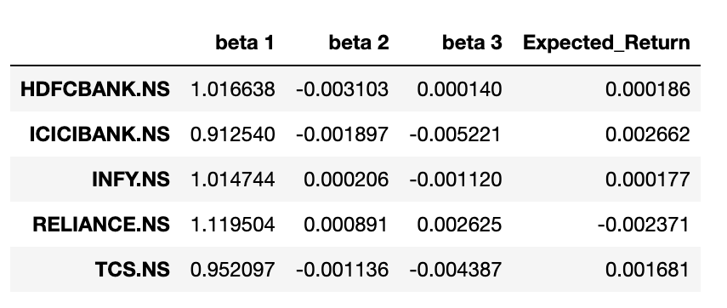
FF3F VS CAPM

Slide 12
Limitations of CAPM
The Main Drawbacks of CAPM is on INPUTS and ASSUMPTIONS:
Risk free Rate(Rf) : The commonly accepted rate used as the Rf is the yield on government securities. The issue with using this input is that the yield changes daily, creating Volatility.
Return on the Market (Rm):The return on the market can be described as the sum of the Capital gains and dividends for the market. A problem arises when, at any given time, the market return can be negative. As a result, a long-term market return is utilized to smooth the return. Another issue is that these returns are backward-looking and may not be representative of future market returns.
Ability to Borrow at a Risk-Free Rate: CAPM is built on four major assumptions, including one that reflects an unrealistic real-world picture. This assumption—that investors can borrow and lend at a risk-free rate—is unattainable. Individual investors are unable to borrow (or lend) at the same rate as the U.S. government. Therefore, the minimum required return line might be less steep (provide a lower return) than the model calculates.

Slide 13
So why doesn’t CAPM work in India?
Because the assumptions underlying CAPM are unrealistic even in a developed market like the US. In an Emerging Market like India, these assumptions verge on the delusional. For example, CAPM assumes that all investors have free access to all information at no cost. This obviously makes no sense in a market like India where even institutional investors have little or no idea of the extent of accounting fraud that most companies engage in (see the next section below as well as Chapter 10 of our book ‘The Unusual Billionaires’ for more details). Another example of a nonsensical assumption embedded in CAPM is that there are no taxes and there are no transaction costs. In reality, short-term capital gains tax is 15% and even for Nifty50 stocks, brokerage costs plus price impact costs are around 0.5% for institutional investors.

Slide 14
Conclusion
CAPM is unfeasible because the composition of the market portfolio is not observable. While various attempts have been undertaken to alleviate this criticism, the CAPM relation has yet to be found in the data, largely shaping the view that it does not hold. However, recent empirical findings challenge this view. Savor and Wilson (2014) document a strong CAPM relation that holds on days during which macroeconomic news is released and vanishes immediately right after. This result is puzzling as it suggests that the CAPM behaves like a hidden “Atlantis” that unveils on occasions.

Slide 15
References
1. https://faculty.iima.ac.in/~iffm/Indian-Fama-French-Momentum/
2. https://medium.com/mlearning-ai/the-capital-asset-pricing-model-capm-financial-analysis-in-python-1a7a4f2c7650
3. https://www.investopedia.com/ask/answers/022515/how-do-i-use-capm-capital-asset-pricing-model-determine-cost-equity.asp#:~:text=The%20capital%20asset%20pricing%20model%20(CAPM)%20is%20used%20to%20calculate,and%20the%20risk%2Dfree%20rate
4. https://www.investopedia.com/terms/f/famaandfrenchthreefactormodel.asp#:~:text=What%20Are%20the%20Three%20Factors,risk%2Dfree%20rate%20of%20return

